Slide 1
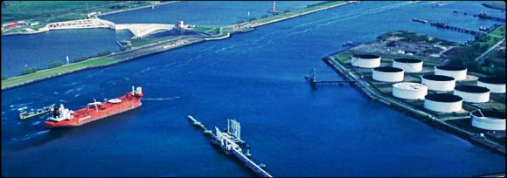
WORLD IMPORTERS Sales and Location analysis
Presented by Mowaninuola adeladun

Slide 2
TABLE OF CONTENT
S/N | Title | Slide Nos.
1 | Introduction
2 | Brief Overview
3 | Aims and Objectives
4 | Problem Statement
5 | Current Situation
6 | Pre- Analysis
7 | Methodologies and Tools
8 | Data Analysis
9 | Key insight- SWOT/risk analysis
10 | Solution and Recommendation
11 | Conclusion
12 | Thanks /Q & A

Slide 3

MEET THE PRESENTER
Name: Adeladun Mowaninuola
Role: Business Analyst & Presenter
Project Involvement: Lead Business Analyst for Sales & Location Analysis Project
Expertise: Data Analysis, Requirement Gathering, Stakeholder Management

Slide 4
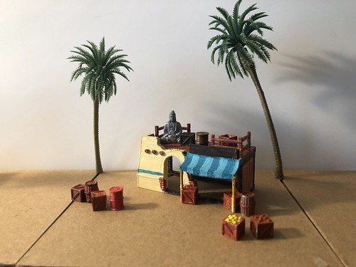
Business Overview
Client is a wholesale importer and distributor of novelty goods operating from San Fransisco Bay area of the United States of America.
Buys novelty goods from Suppliers, Manufacturer and Wholesalers, they also engage in buying packaging materials in large quantities and warehouse.
They sell to their customers via network of agents, wholesale Customers in turn resell to retail outlets across the network.
Growing competition , increasing sales dynamics and rising Customer expectation makes it imperative for the Management of to embark on the project to reorganize and consolidate operations for business optimization and reduced cost of doing business

Slide 5
Aims & Objectives
Aims
To be able to make Strategic (prompt and insightful) business decisions
To reduce cost of doing business
To gain Competitive advantage
Profit optimisation.
Objectives
To identify high volume Provinces,
Customer Profiling
Carry out market analysis and customer requirement survey
Create workable sales strategies
Project a 3-year revenue forecast
Present report and insight

Slide 6
Problem Statement
Sales activities cover 49 Provinces in the entire Country under the following situation;
Increasing overhead.
High cost of logistics/transportation/distribution across network of Customers.
Customer concentration/population across various provinces
Customer service and support inadequate
Monitoring across board is cumbersome
Globalization constitutes impediment to growth and development

Slide 7
Pre-Analysis Work
An elicitation meeting with the CEO (BO) and relevant stakeholders held to discuss goals and expectations of the proposed project resulted in high level requirements breakdown as follows :
Data modelling - This step involves ensuring that we are using the appropriate data, defining and organizing data elements and the relationships between them to support the requirements of our analysis.
Data Analysis - Data analysis is the process of inspecting, cleansing and transforming data with the goal of discovering useful information, informing conclusions and insights supporting decision-making.
Forecasting- This process involves the prediction or estimation of future trends based on past and present data, patterns, and analysis.
Business Process Flow- A visual representation of the steps and activities involved in completing a specific business process or workflow from start to finish.
Reporting- in this process we shall be collecting, organizing and presenting data and insights to stakeholders., summarizing key information from various sources, such as databases, spreadsheets, and other systems, into meaningful reports and visuals that support decision-making and monitoring.

Slide 8
Methodology & Tools
Agile methodology being used in association with the underlisted tools:
Confluence -Project planning, collaboration within team, documentation
Jira-project management, reporting and tracking.
SQL-Data analysis and Investigate relationship between data.
Power BI-Data analysis, modeling, visualization and reporting.
Draw.io- Business process flow chart.

Slide 9

Methodologies & Tools
Agile methodology being used in association with the underlisted tools:
Confluence -Project planning, collaboration within team, documentation
Jira-project management, reporting and tracking.
SQL-Data analysis and Investigate relationship between data.
Power BI-Data analysis, modeling, visualization and reporting.
Draw.io- Business process flow chart.

Slide 10
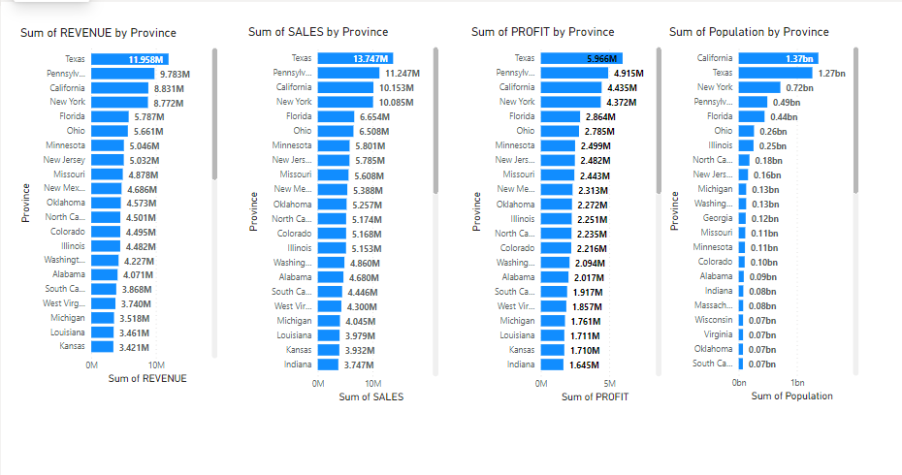
Current Situation @ WWI
5 Provinces of a total of 49 Provinces deliver 26% of Total revenue, 26% of total sales and has 62% of customer population,
Where total sale-$198.04M
Total revenue-$172..26M
Total Profit-$85.73M
Total Population- 7.02 bn Chart reveals direct relationship between Population and Clients Business activities

Slide 11
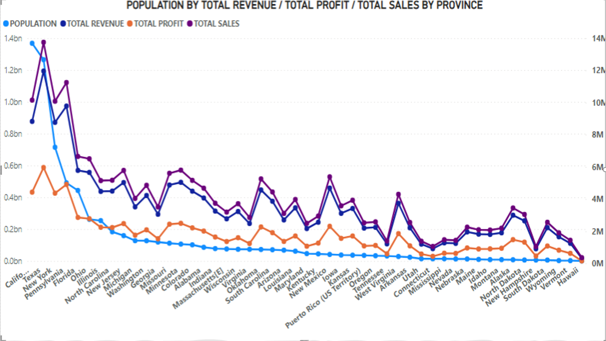

Slide 12
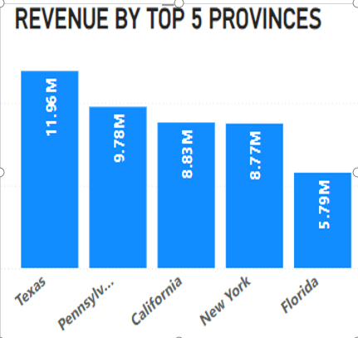
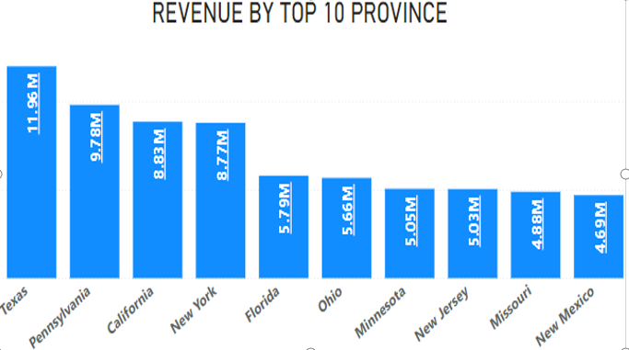
Revenue Analysis
Top 5 Provinces delivering over 26% of the current business revenue of $172.26M
And the next 5 gives additional 15%
Top 10 Provinces deliver 42% of total business revenue

Slide 13
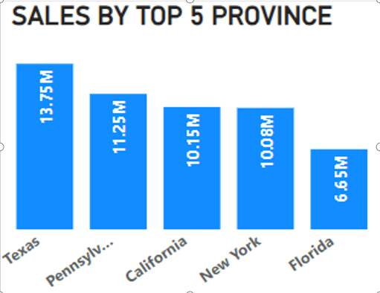
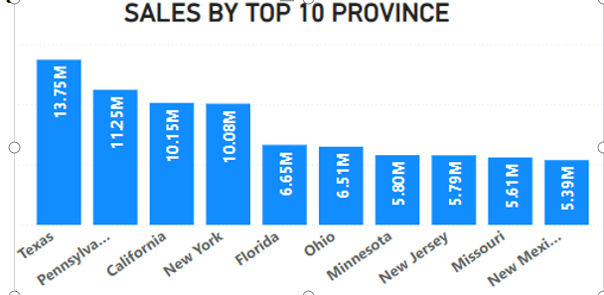
Sales Analysis
Top 5 Provinces ,with a total sales figure of $51.89M constitutes 26% of total sales of $198.04M for the entire 49 Provinces
The next 5 Provinces total sales of N29..09M being 15% of all 49 provinces total sakes
Topm10 Provinces contributes a total of 40% in sales.

Slide 14
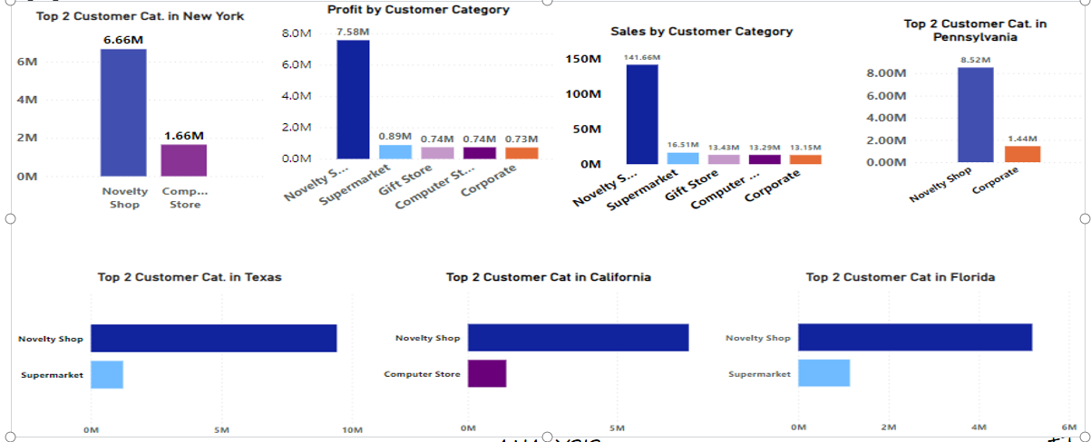
Top 5 Provinces Customer Categorisation
hi This analysis reveals the Novelty shop as the number 1 Customer category, recording total sales figure in excess of 70% in each of the Provinces
The Supermarkets ,Computer stores and corporate shops are the 2 Customer categories in these provinces respectively, however they contribute less than 10% in sales.

Slide 15
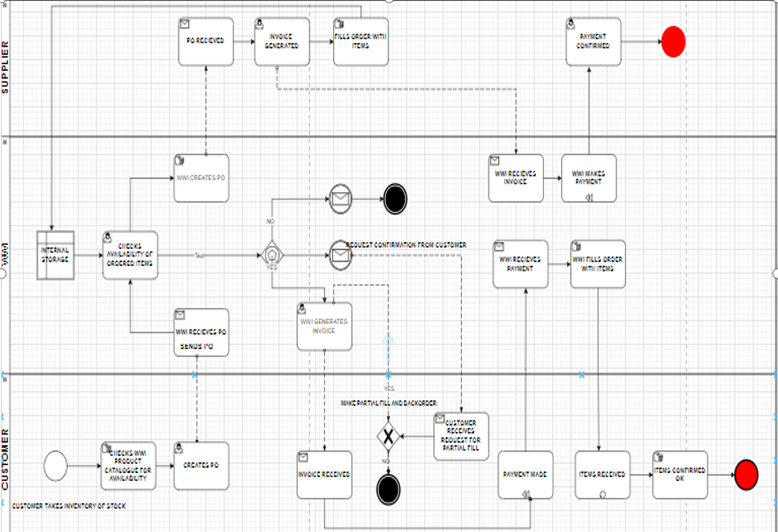

Slide 16
Business Process Flow
Process is elongated
Cumbersome
Avoidable repetitions
Manual
Bottle necks at key junctions

Slide 17
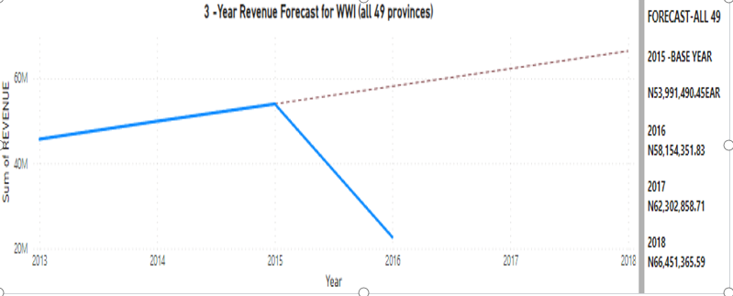
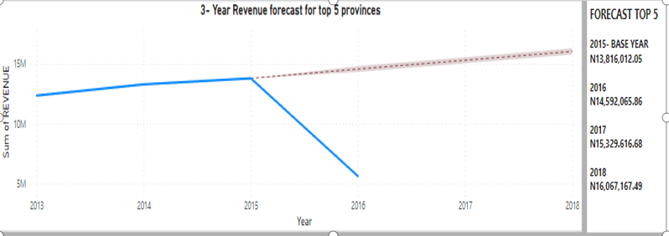
Forecast
Forecast reveals potential for growth
Total districts average growth of 7%/annum
Top 5 districts average growth of 4%/annum

Slide 18
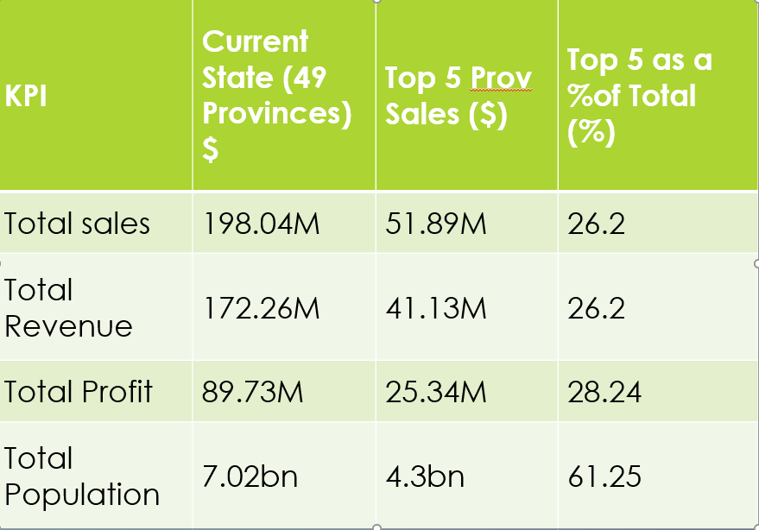
Insights @ a Glance

Slide 19
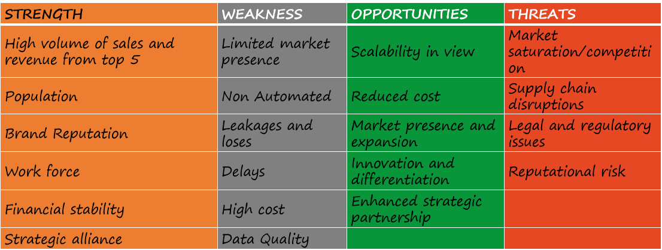
SWOT Analysis

Slide 20
Risk Analysis
Data quality
Finance and Budgeting
Operational /management factors
Market volatility/environmental influence
Socio political factors
Competitive pressure
Change management

Slide 21

Solutions & Recommendations
In view of the analysis and findings , these are some insightful recommendations in support of the proposed restriction of business operation to 5 top selling Provinces::
Automation-To reduce manual effort, improve efficiency and consistency in execution.
Embrace e- commerce- creating an on line shop front
Customer engagement-It involves building and nurturing relationships with customers .
Product Customisation- This is make–to-order
Supply chain alignment and collaboration (strategic alliance)
Controls-Monitoring and compliance
Well-groomed business development./marketing and sales Team

Slide 22

Solutions & Recommendations
(Automation)
Here are processes recommended for automation;
Order Processing: When technology is involved,, orders will be better managed, invoicing will be machine generated and orders efficiently manage incoming orders, invoicing, fulfilling orders –processing of orders will be reduced to an average of 5 days from the current 8days.
.Inventory Management- this will result efficient warehousing management will result in better stock update/restocking /track inventory movement and automate replenishing .When this is put in place the instances of backordering will be reduced by about 15%.
Supply Chain Management:- Now that on-line business activity is being considered , tracking should be put in place, Client will be able to monitor orders at different levels along the supply chain , this will reduce leakages and losses that is currently being experienced to about 1%
Sales Reporting and Analytics:-This will facilitate adequate tracking of sales and personnel performance in these regions and formulation of appropriate strategies, resulting in optimisation across board
Performance Monitoring and KPI Tracking: provide real-time visibility into business performance, track progress towards goals, and trigger alerts for any deviations

Slide 23

Solutions & Recommendations,
(Embrace E-Commerce)
This is online shop floor being recommended in order to expand market share beyond geographic boundaries and time limits -
This will impact sales within the new business model by over 15%
Increase revenue within the new business model by about 25%
Reduced operation cost- Cost associated with renting and maintenance of facilities will reduce by about 21%, however its expected cost associated with logistics and deliveries will increase.,
This will also avail learning opportunities in the new model resulting in Scalability and flexibility in the nearest future.

Slide 24

Solutions & Recommendations
(Supply Chain Mgt. & Control)
We recommend a well-structured supply chain focusing resources on the top-selling provinces, Client can optimize inventory management, production scheduling, and distribution processes to meet demand more effectively, reducing lead times and minimizing wastage across board and will result in cost reduction by over 10%
Prevent leakages and losses
Controls are recommended to monitor the supply chain, access to data should be restricted to designated personnel to prevent piracy and corruption , Product quality and regulatory compliance.
The personnel who interface with the business commanaccessd munity play a pivotal role in driving customer engagement, sales growth and market expansion, hence .must be well equipped as ambassadors of the Business.

Slide 25

Solutions and Recommendation
(Product Customisation & Customer Engagement)
Personalisation of product can increase customer satisfaction and reduce product returns and exchanges by up to 5%
If customisation is effective, it will increase customer brand loyalty and competitive advantage –this can increase sales and optimise business to the tune of over 10% within the individualistic/elite class of Customers
Customer engagement will result in valuable insights that will impact formulation of strategies and improved customer satisfaction and subsequent optimisation of sales and revenue.

Slide 26
Conclusions
Findings and insights from our data analysis of the 49 Provinces within which Client operates show that
The top 5 most Populated Provinces impact Sales, revenue and profitability by over 26 % respectively.
3 year forecast reveals an opportunity for growth in excess of 21%.
Further analysis of SWOT , potential Risk and benefit demonstrates alignment with strategic objectives and aims of optimization and cost reduction.
We conclude that if Client aligns resources and processes as highlighted in the recommendations and restrict business operation to Texas, Pennsylvania ,California , New York and Florida while prioritizing the top 2 Customer categories in these selected Provinces in line with the 20: 80 rule this proposed Model will be a great success.

Slide 27



The way to get started is to quit talking and begin doing
Walt Disney
The way to get started is to quit talking and begin doing
Walt Disney

Slide 28
Our Team
Mowaninuola Adeladun
BA/PO
Team Lead
Noa Bill
Developer
Tech Team
Jenny Ettah
Data Analyst

Slide 29


